Slide 1
Modeling and Prediction Training and Testing
Melinda Higgins
03/25/2020

Slide 2
Modeling – fit equation to data
Best fit line – minimize residuals
Alternative – a curved line
Guess at best fit line
Line anchored at 0,0

Slide 3
Data

Slide 4
Model Y = β₀ + β₁*X + ε

Slide 5
Model Predictions
Original Data

Slide 6
Model Y = β₀ + β₁*X + ε
Model “Errors” (aka. “residuals”)
Incorrect model → lack of fit
Measurement uncertainty
Assumed to only be in Y (outcome response)
But can also be in X (independent “fixed”)

Slide 7
Model Predictions
Predict the expected (mean) response at a given value of X
95% Confidence Intervals are for the MEAN (average) response of Y at X
95% Prediction Intervals are for an INDIVIDUAL response of Y at X – always WIDER
BOTH intervals will be narrower where there is “more data” or “higher concentration of data points” – more information – more confidence
NEVER EXTRAPOLATE (outside of X’s)

Slide 8
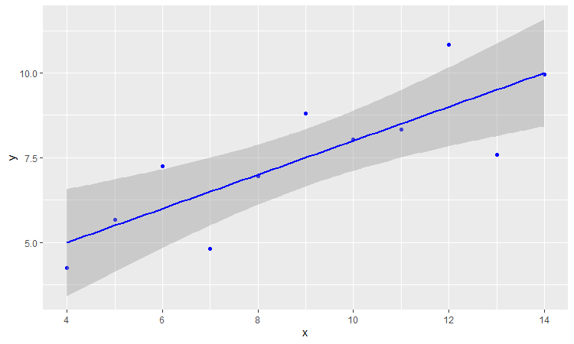
Model Predictions
95% Confidence Intervals for Mean

Slide 9
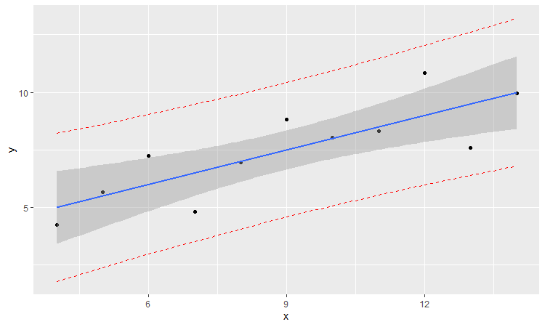
Model Predictions
95% Predictions Intervals
For individual values

Slide 10
Training and Testing
To get a good idea of how the model will perform with new (unknown, future) data
Typically split the data usually 70/30 or 80/20 training, testing
Sample at random (without replacement) 80% of the data
Use these to TRAIN (create) the model
Use the remaining 20% to TEST the model (prediction)

Slide 11
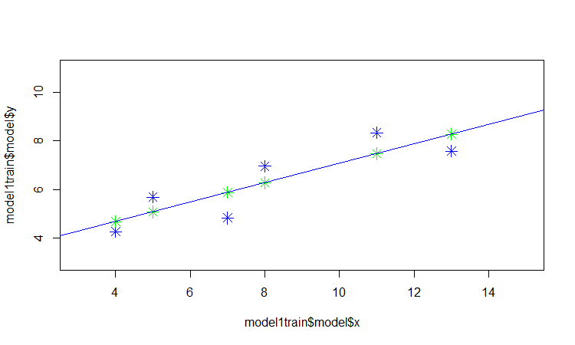
Anscome Data – Training – random set 1

Slide 12
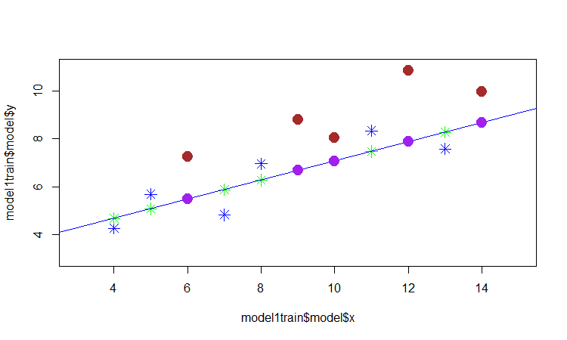
Anscome Data – Test – random set 1

Slide 13
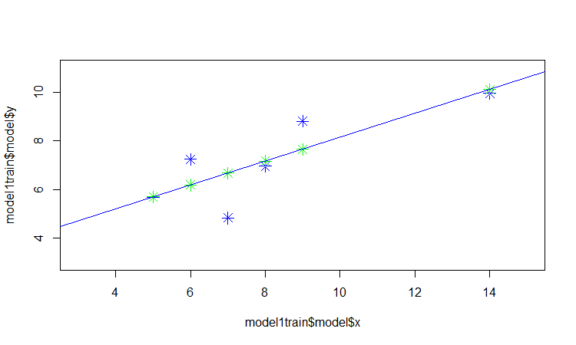
Anscome Data – Training – random set 2

Slide 14
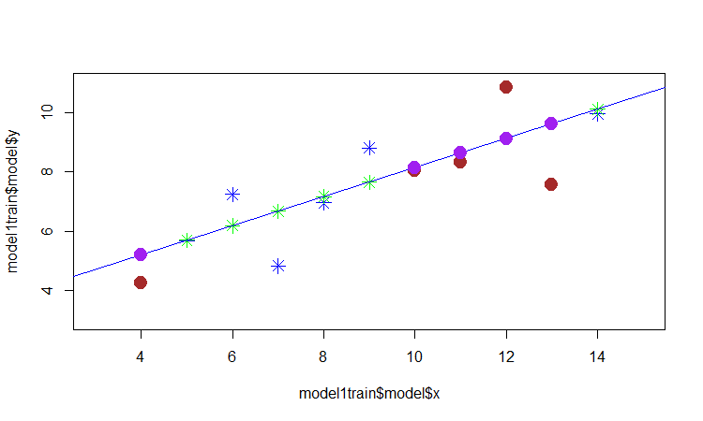
Anscome Data – Test – random set 2

